Slide 1
HiCDB: a sensitive and robust method for detecting contact domain boundaries
Fengling Chen
Supervisor: Michael Q. Zhang & Yang Chen
MOE Key Laboratory of Bioinformatics
Bioinformatics Division and Center for Synthetic and Systems Biology, BNRist Department of Automation, Tsinghua University
14 October 2018

Slide 2
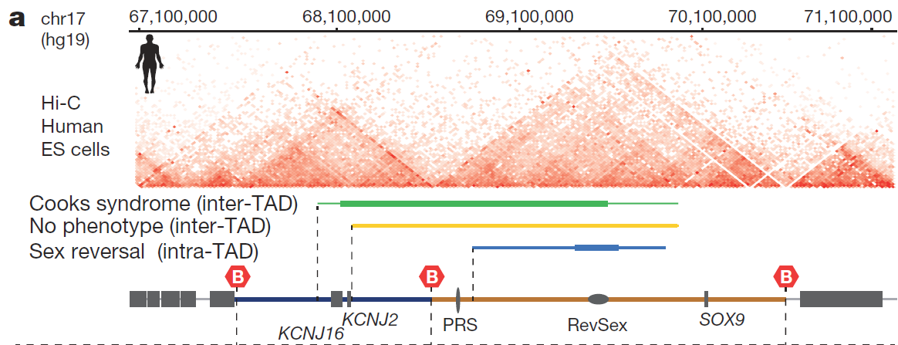
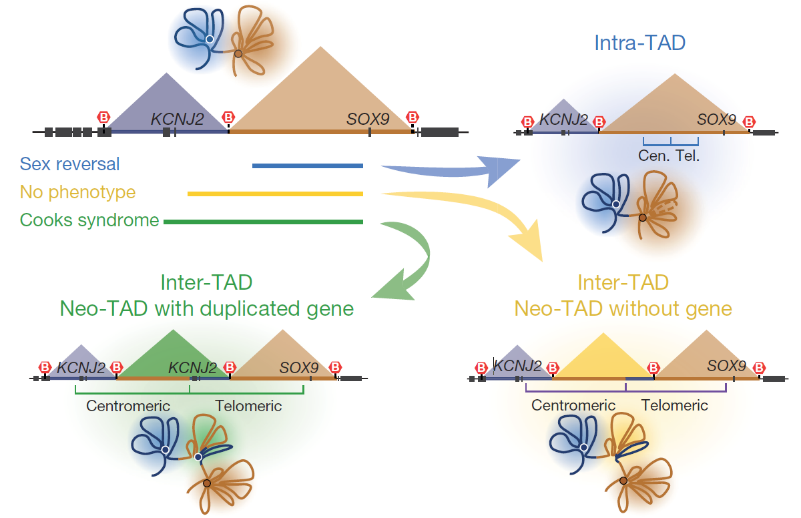
1. Background & Motivation
contact domain boundary (CDB)
Why new CDB detecting methods ?
existed methods were not fully evaluated.
not updated for high resolution
not robust enough to detect differential CDBs
not specially designed to better detecting CDBs under highly-connected regions
genome-wide analysis of
epigenetic features of CDBs
function of cell-type specific CDBs
contact domain boundaries (CDBs) includes TAD boundaries and sub-TAD boundaries.
TADs： invariant/conserved; absolute insulated
sub-TADs : varied ; cell-type specific gene regulation; relatively insulated
Formation of new chromatin domains determines pathogenicity of genomic duplications. Franke et al. Nature. 2016
Notes:
So many methods exist for detecting domains , why need us bother to develop new CDB detection methods
no clear biological and mathematical definition, existed methods were not fully evaluated.
some methods haven’t update for current high resolution (slow or not suitable for high resolution)
most methods are not robust enough to detect differential CDBs
Methods were not specially designed to better detecting CDBs under highly-connected regions
contact domain boundaries (CDBs) includes TAD boundaries and sub-TAD boundaries.
TADs： invariant across cell types and conserved across species; absolute insulated
sub-TADs : vary across cell types; associated with cell-type specific gene regulation; relatively insulated

Slide 3
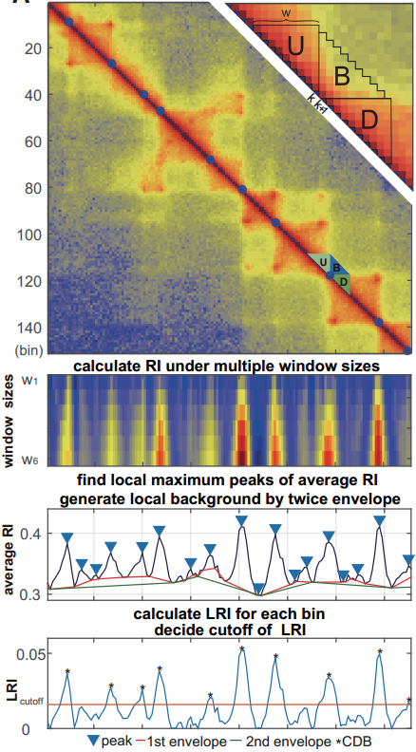


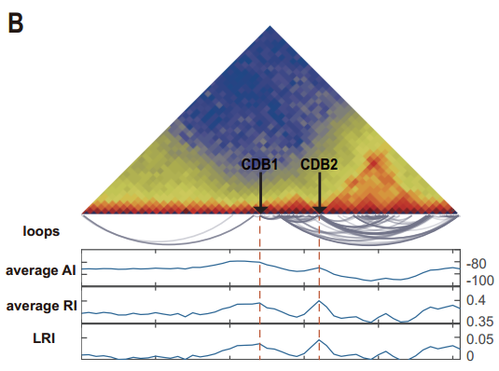
2. HiCDB Method
Calculate relative insulation (RI) under different window size
Peak detection on average RI
Remove background
Cut-off chosen (GSEA-like method)
highly-connected domain
aRI or LRI can be compared genome-wide
aRI or LRI help to find CDBs under highly-connected domains.

Slide 4
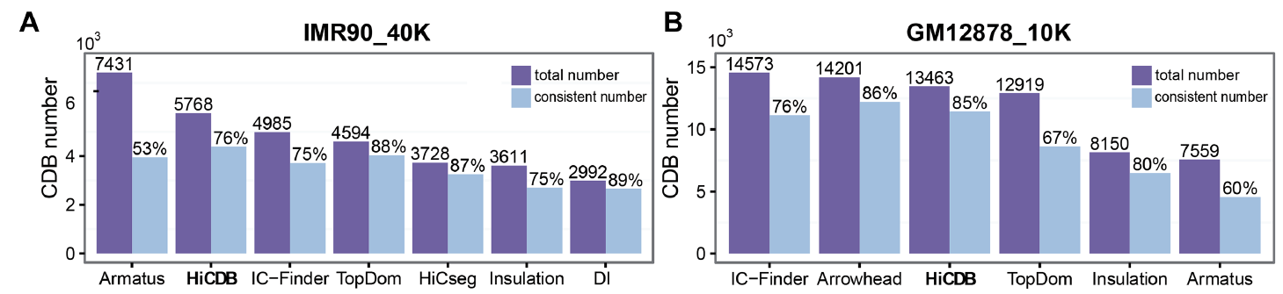
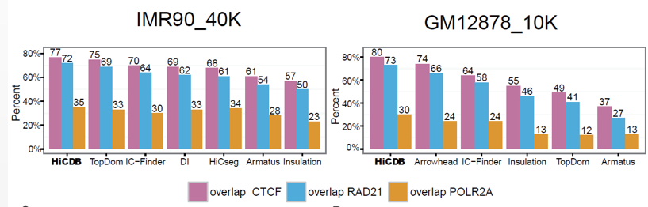
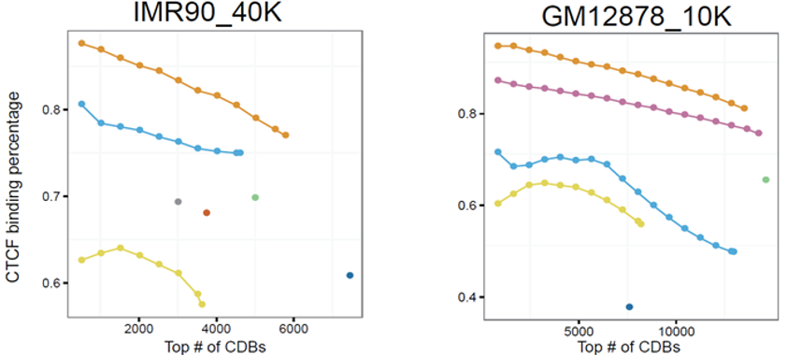
3. Compare with other methods
All comparisons were carried on at 40kb-resolution and 10kb-resolution datasets
Consistency between all methods
CTCF/cohesin and active regulatory signal enrich on HiCDB detected CDBs
Percentages of CDBs overlapped with protein ChIP-Seq
CTCF binding percentages of the HiCDB-detected CDBs were always the highest for different cutoffs
Notes:
the CTCF binding percentages of the HiCDB-detected CDBs were always the highest for different cutoffs

Slide 5
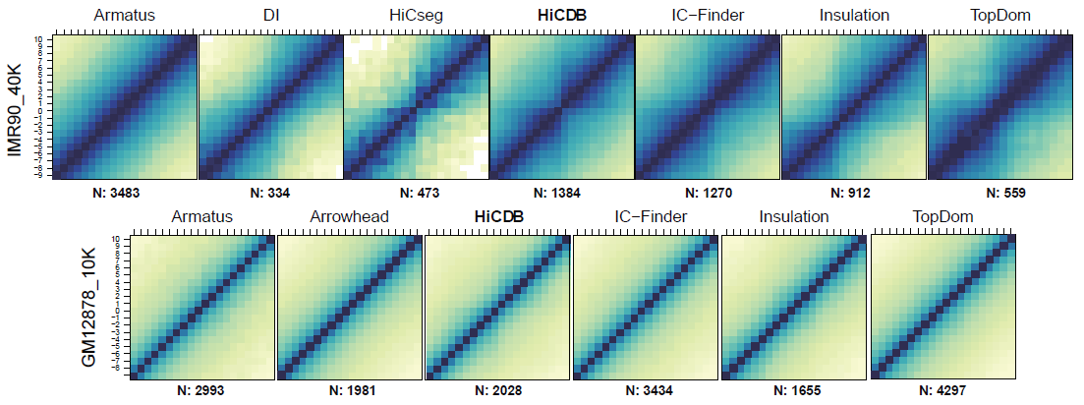

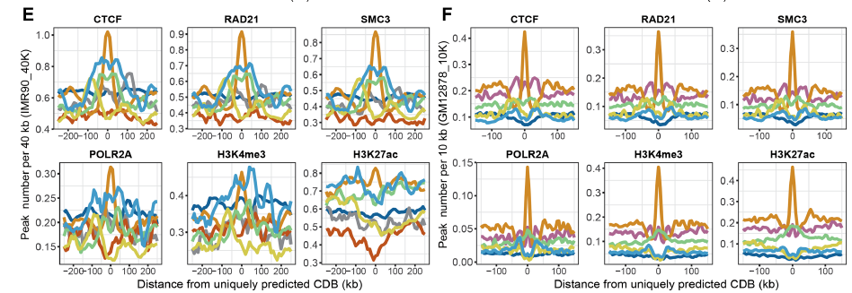
3. Compare with other methods
Evaluation of uniquely detected CDBs of each methods
aggregation of Hi-C interactions at uniquely detected CDBs
aggregation of ChIP-Seq signal at uniquely detected CDBs
HiCDB uniquely detected CDBs are meaningfull.

Slide 6

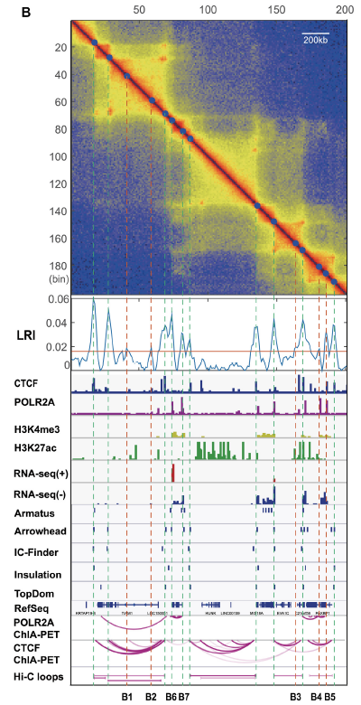
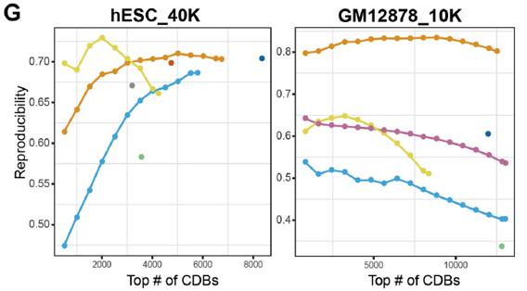
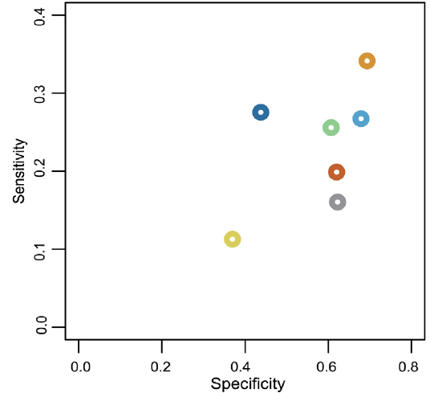
3. Compare with other methods
Method reproducibility at different cutoff
Sensitivity / Specificity
(use CDBs detected on high resolution Hi-C data as TRUE)
comprehensive metrics:
the CDB number, consistency, protein binding enrichment, robustness and time complexity.

Slide 7
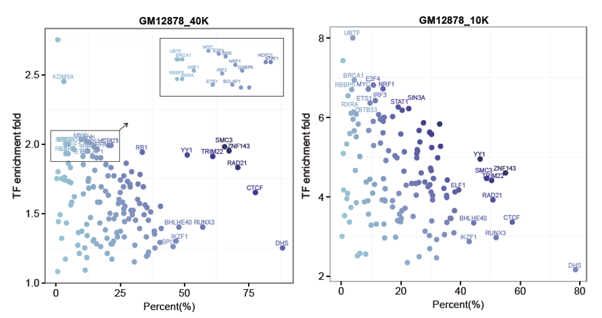
4. Epigenetic features of CDBs
CDB enriches structural regulator as well as cell-type-specific TFs
TRIM22 is probably a structural regulator(GM12878 & MCF-7)
over random
over random

Slide 8
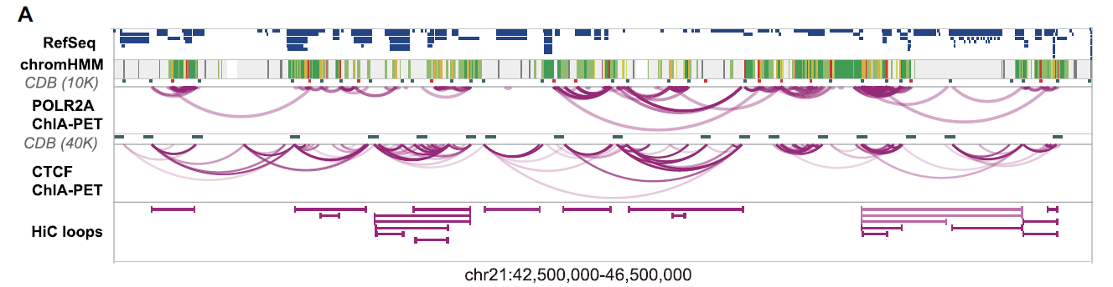
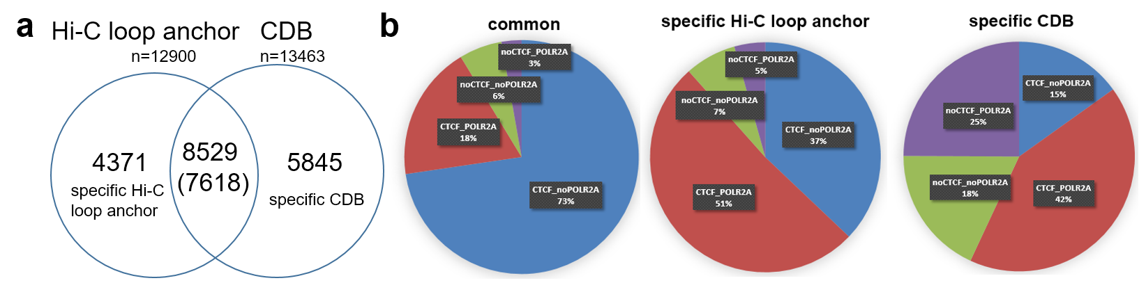
4. Epigenetic features of CDBs
CDBs cover more CTCF independent regulatory regions than Hi-C loops detected by HiCCUPS
12%
43%

Slide 9
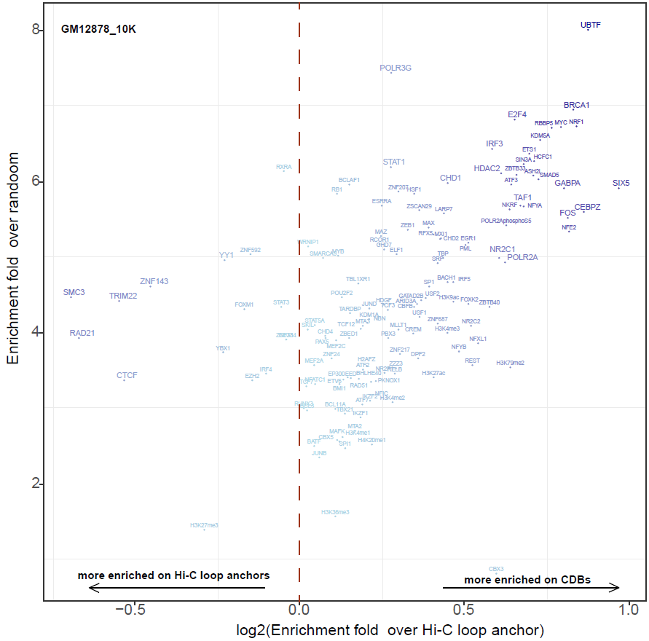
4. Epigenetic features of CDBs
at CDBs
The enrichment of CTCF independent loops and cell-type-specific TFs on CDBs strongly suggest that
the CDBs are not only structurally but also functionally related to transcription regulation.
Notes:
CDB和loop的锚点有很多重合，并且相对loop更加富集细胞特异的功能。可能与CTCF及pol2A的结合方式有关，CTCF是介导更为稳定的结构，能够呈现局部极大点，Pol2结合更加动态，呈现局部insulation的状态，易于被HiCDB检测。

Slide 10
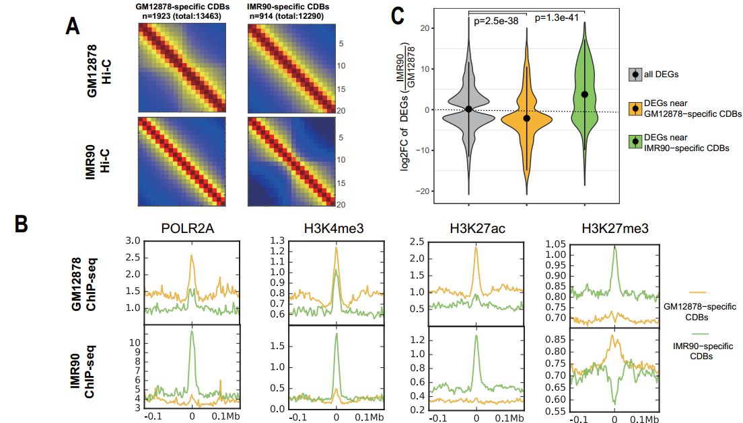
5. Differential CDB detection
Emergence of CDBs are frequently associated with the activation of nearby cell-type-specific genes.
cell-type-specific CDBs correlate with cell-type-specific histone modifications
GM12878-specific CDBs：B cell activation, interferon-gamma-mediated signaling pathway etc.
IMR90-specific CDBs：lung development etc.
aggregation of Hi-C interactions at specific CDBs
nearest genes in 500kb(+/-)
aggregation of ChIP-Seq signal at specific CDBs

Slide 11
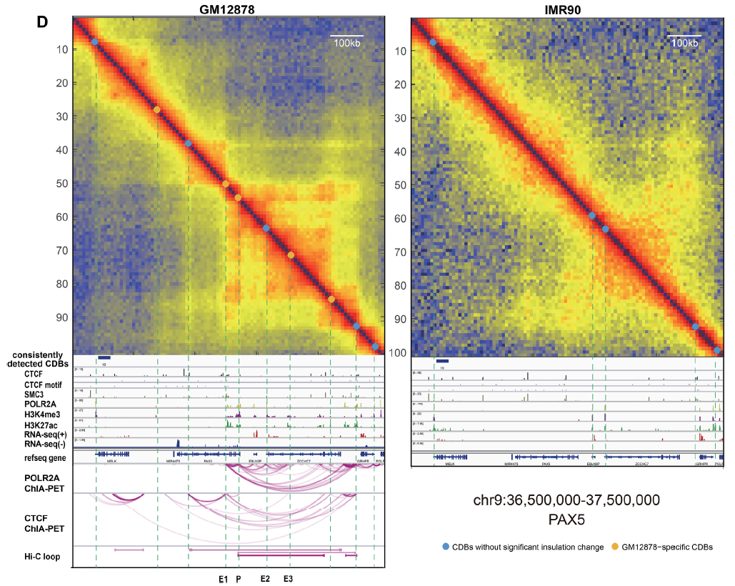
5. Differential CDB detection
Differential CDB example
Cell-type-specific CDBs correlate with cell-type-specific histone modification and gene activation.

Slide 12
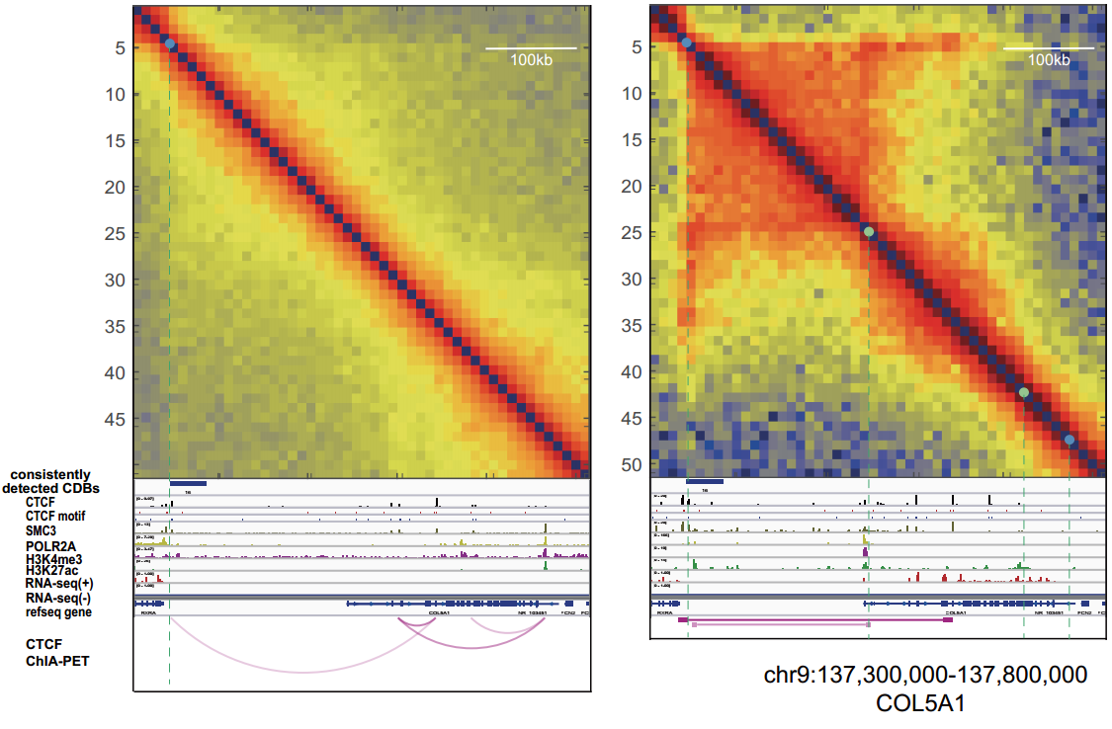
5. Differential CDB detection
Differential CDB example
Cell-type-specific CDBs correlate with cell-type-specific histone modification and gene activation.

Slide 13
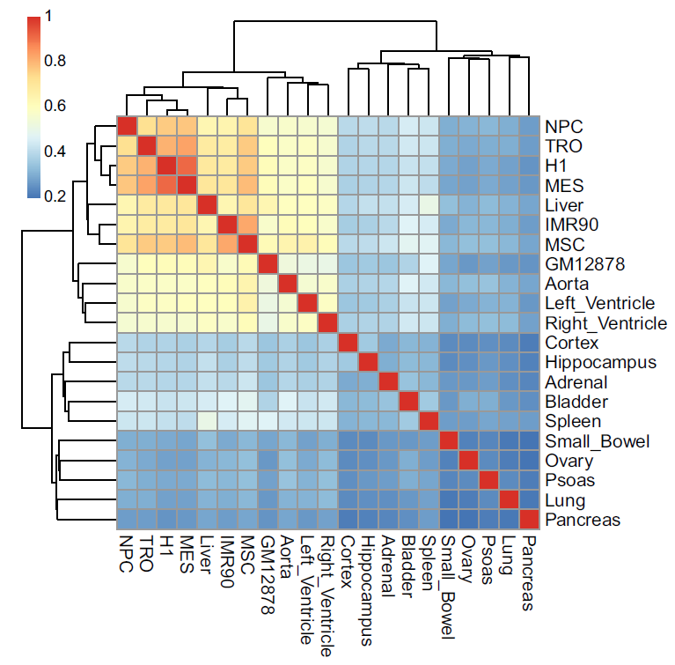
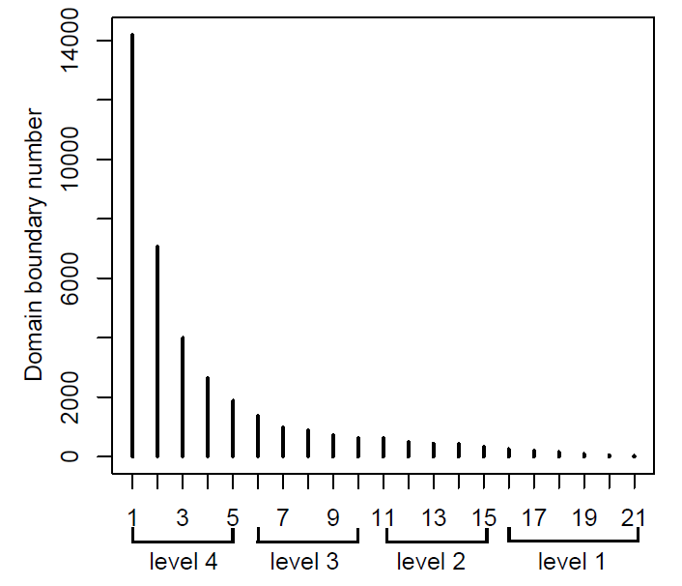
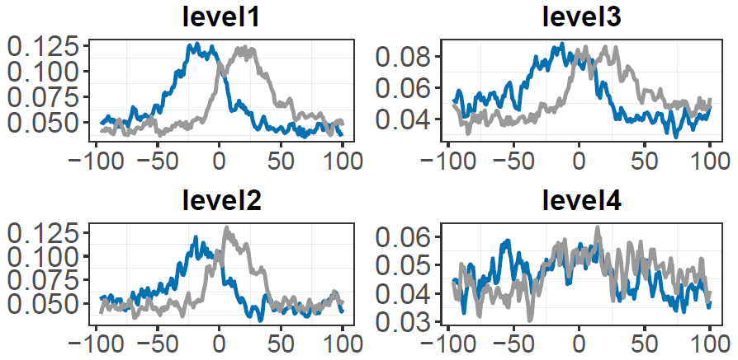
6. Applying HiCDB on 21 cell types
Spearman correlation of CDB aRI values
CDB consistency across 21 cell types
Total CDBs: 37518; avg 6615
invariant CDBs (level 1): 2542
(available on github)
Present as CDB in # cell types
CTCF motif around boundaries
hES-derived
same as compartment
heart
brain
CTCF motif is more divergent at invariant CDBs
A compendium of chromatin contact maps reveals spatially active regions in the human genome[J]. Schmitt A D, et al. Cell reports, 2016.

Slide 14
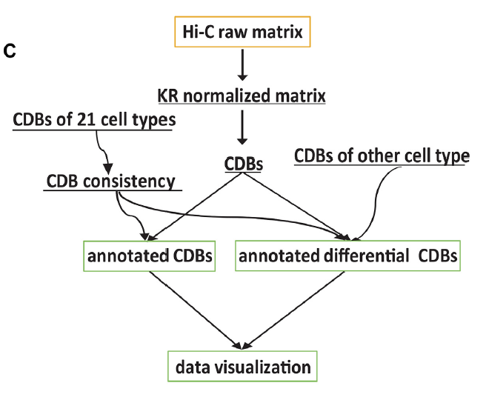


Take home messages
HiCDB is fast and sensitive which can be applied to multiple resolution.
Applying relative insulation, HiCDB is powerful in defining CDBs within highly-connected regions. Relative insulation is associated with gene regulation and histone modification.
Use HiCDB to find functional structure differences between conditions.
Refer to our comprehensive comparisons to select boundary detecting tools.
https://github.com/ChenFengling/RHiCDB (R)
https://github.com/ChenFengling/HiCDB (matlab)
Overview of HiCDB package

Slide 15



Acknowledgement
Dr. Guipeng Li
Research Assistant Professor
Medi-X Institute, SUSTech
Prof. Michael Q. Zhang
Dept of MCB, Center for Systems Biology,
UT Dallas, USA
TNLIST, Tsinghua University
Dr. Yang Chen
Research Assistant Professor
TNLIST, Tsinghua University

Slide 16
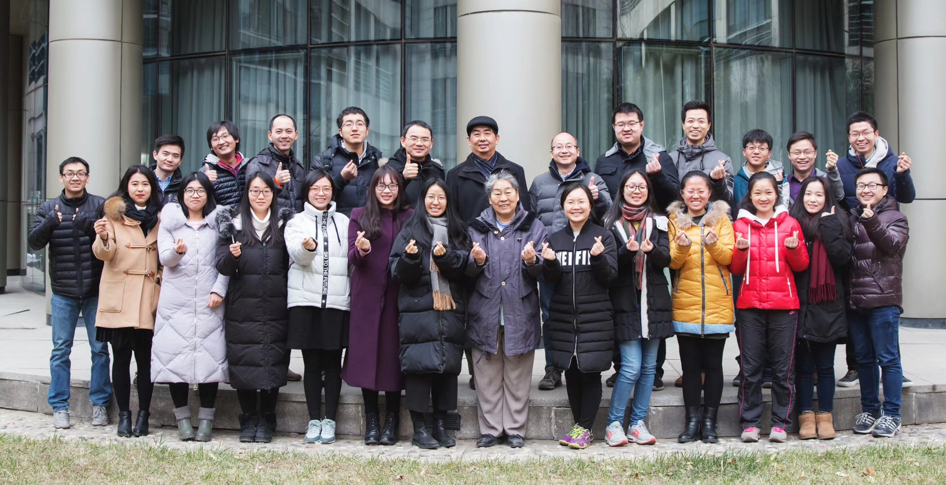
Michael Q. Zhang Lab @ THU
2017.12
Thank you！
Fengling Chen 陈凤玲: Ph.D. candidate
Email: cfl15@mails.tsinghua.edu.cn
fchen@github

Slide 17
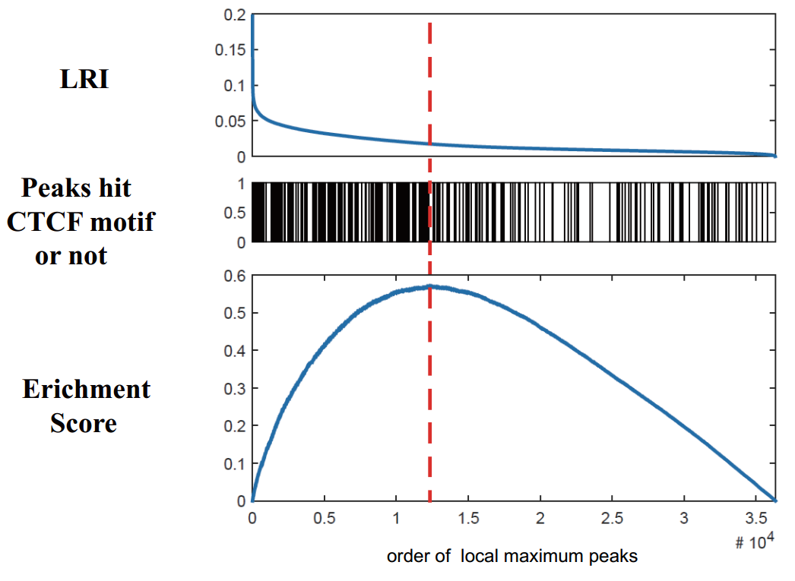
2. HiCDB Method
cut-off chosen

